Slide 1
Stumbling Towards Success
From Surviving To Thriving When You Don’t Have A Clue (And Your Client Doesn’t Either)
Nolan Egly
Notes:
Hi everybody! Today we’re talking about how to stumble towards success, even when you are a complete newbie on an ongoing project and don’t have a clue what you’re doing.

Slide 2

What this talk is and isn’t
Notes:
Before I begin, I wanted to anchor on what this talk is and isn’t, so you can decide if you want to be here or not.
We’re all busy people with things to do and places to go, and I want to be respectful of your time by trying to help you choose if this will informational, or at least possibly interesting.

Slide 3
The menu at a glance
A personal journey story
Tools and techniques
Sharing the stage
about doing a three month assessment
for self-actualizing and organizing
with the audience for other experiences
Notes:
So, let’s take a look at the menu! I’m going to use a food analogy. Imagine, if you will, that you’re strolling along a crowded street with a row of restaurants, and you stop at the board sign outside, and you scan the offerings to see if you want to commit your time to the experience...
Here’s “today’s specials”, so to speak. {{ READ SLIDE SECTIONS AND EXPOUND SOME }}

Slide 4

So there is nothing new under the sun
Notes:
I'd hesitate to say any of this is new or original. But, it is colored by my experiences, and I frequently get insight and ideas from resources of the "behind the scenes" or "how I do such-and-such" nature.
So I wanted to
1) share my own perspectives and techniques
2) since this is a small group, open the floor to what others have found helpful

Slide 5

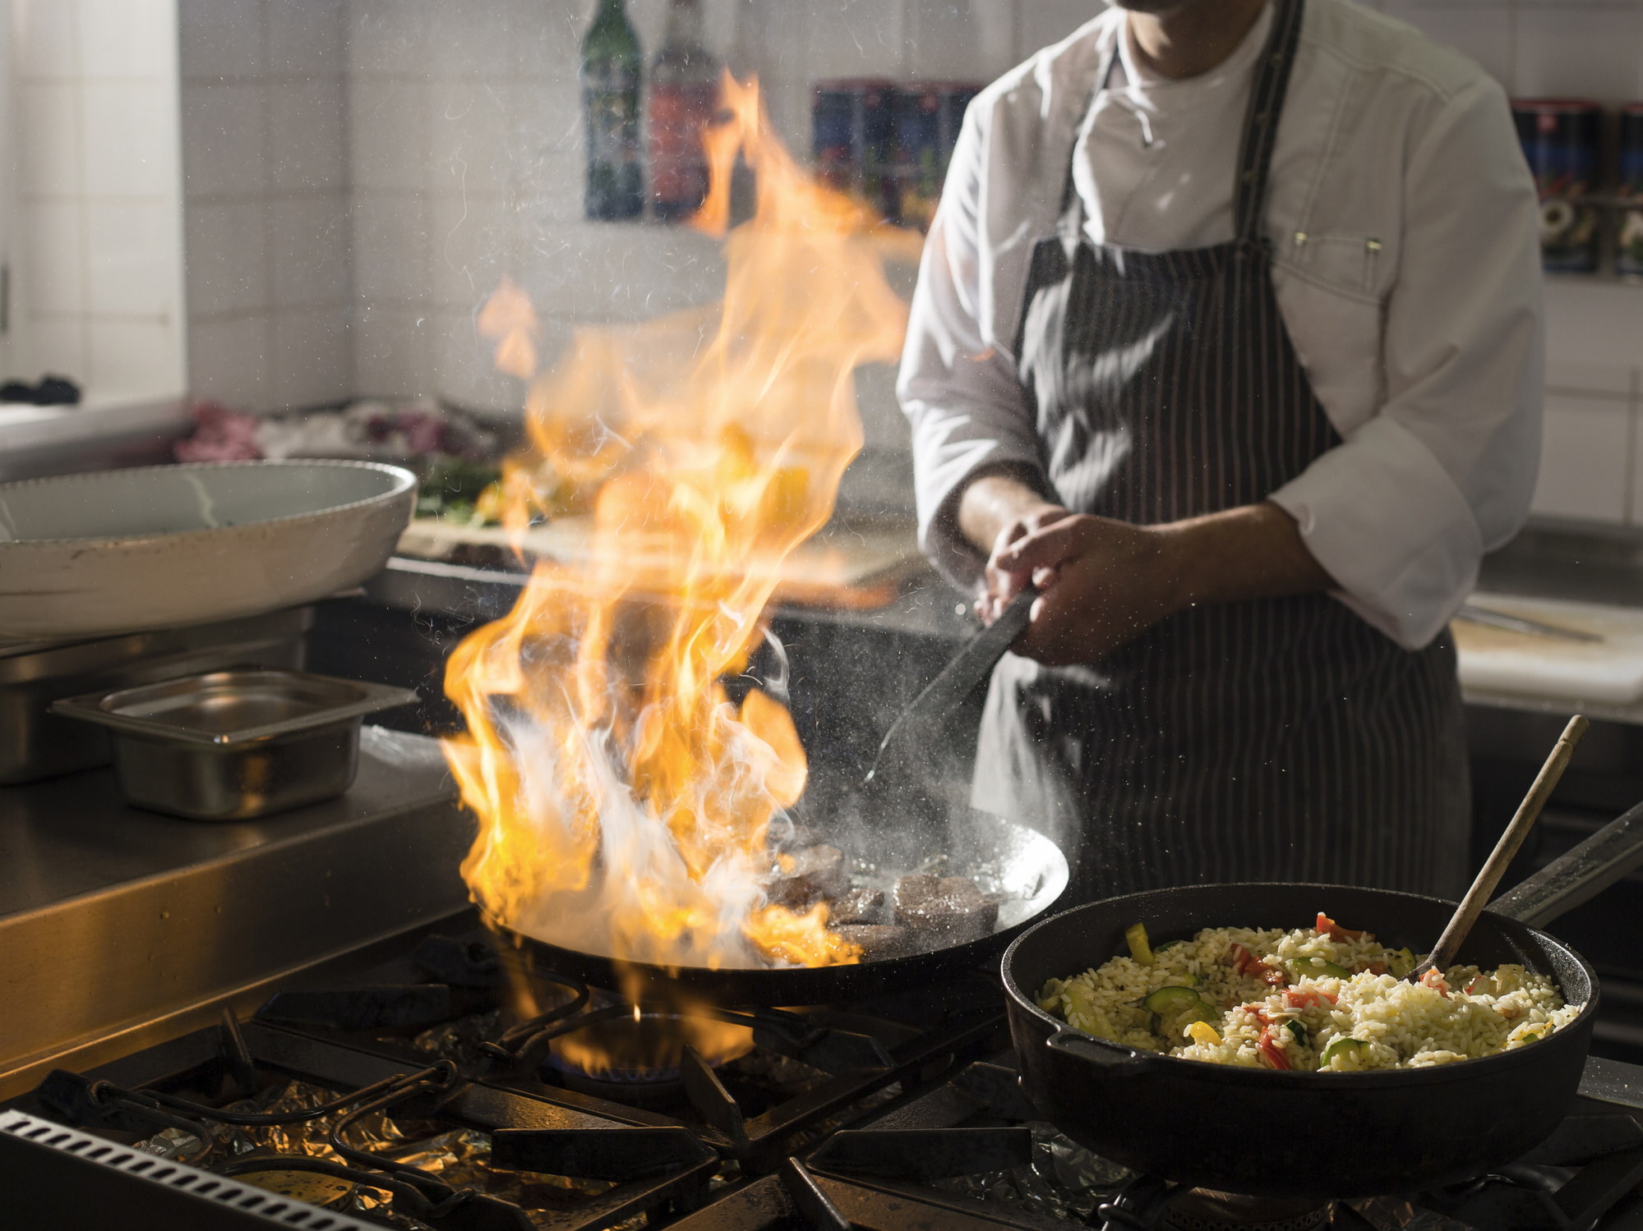

Your Call To Action!
Vote with your feet
Have a seat
Ask the chef
Not for me.
Sounds great!
I’m not sure…
Notes:
So it’s your call to action! Yes, already – in this presentation, the CTA comes at the beginning, not the end. Now that I’ve laid out the scope, if this doesn’t sound interesting or applicable to you, I want to invite you to feel free to drop and focus on your next important task, without any sense of shame or guilt about yourself – focus on what makes the most sense for you – or without any concern about hurting my feelings. If everyone drops off and I’m left here by myself, I’ll be ecstatic – it means I’ll have learned what topics our group isn’t interested in.
If this does sound useful or interesting, great! We’re about to get started. But first I’m going to pause, and open the floor to anyone who’s still undecided, and has that one critical question that will make or break whether you stay tuned in or not.
What can I clarify about the menu, before we start cooking?

Slide 6
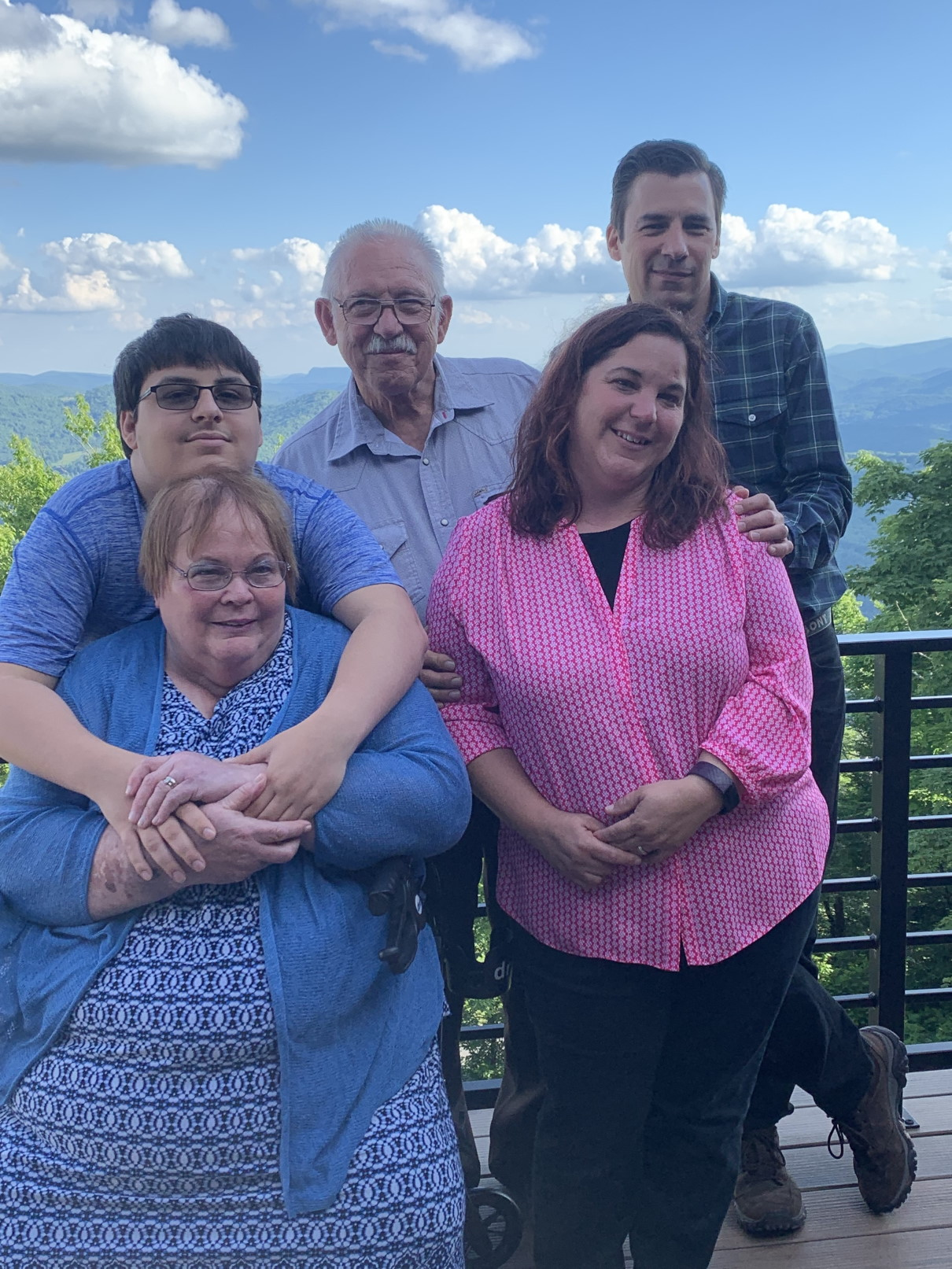

About Me - Nolan Egly
Software Product & Platform Engineering Manager
Technical Lead
(aspiring architect)
AWS Certified
(Cloud practitioner)
Product & Platform Engineering Services
Austin, TX
Notes:
I’ve been developing professionally for 18 years, and “unprofessionally” since I was 8. I’m blessed to have found something I’m passionate about!
I am a Tech Lead, have guided multiple small teams, designed apps and small systems from the ground up, redesigned and fixed badly implemented systems, assisted with multiple technical assessments
aspiring to go to the “next level” as an architect here at PPES
I’m a certified AWS Cloud Practitioner
Worked at product companies and consultancies, in
Pharmaceuticals/ Health Care
Criminal Laboratory Systems
Logistics
Criminal Justice
Natural Gas
Manufacturing
Retail
Company sizes ranging from Small Startups to the Medium Enterprise level...
Been with Accenture since April 2022, came from the Headspring acquisition
Fun fact: I have a household of 5 – my wife and I, a 19 year old son, and my retired disabled in-laws

Slide 7
Survive!
Organize!
Thrive!
Define
Organize
Execute
Notes:
Here’s the journey we have ahead of us. We want to be thriving, but when we first start out – let’s not mince words or fool ourselves – when we first start we’re going to be in survival mode.

Slide 8
The engagement
Three month assessment for a role called Convergence Architect
Company had multiple products across different groups
Executives wanted to combine them into a new SaaS offering that was being developed
Exec perception was that this was “easy”, but our stakeholder said “I don’t know how to do this”

Slide 9
Mapping The Territory
Client executive stakeholder wants a detailed roadmap and to execute a POC
Accenture leader wants to fulfill the SOW terms so we get paid
Client architect wanted to highlight the questionable strategic value
Accenture architect wanted to validate the proposed Landing Zone architecture
Product groups wanted nothing to do with the entire affair
Notes:
As I came in and was introduced to all these different people and teams involved in ongoing efforts, I started to feel I was going to be pulled in multiple directions.
{{ READ THROUGH THE POINTS }}
Very quickly I realized that I was going to have to invest in building consensus. Or try, at least.

Slide 10

Consensus is foundational
Notes:
The foundation of any functioning group is consensus – defining the goals, and often the operating parameters or constraints
- from interpersonal relationships like marriage/partnership
- Legal organizations like businesses and charities
- countries
Without consensus - without a foundation to build on - these endeavors will fracture, ranging from split-ups to civil war

Slide 11
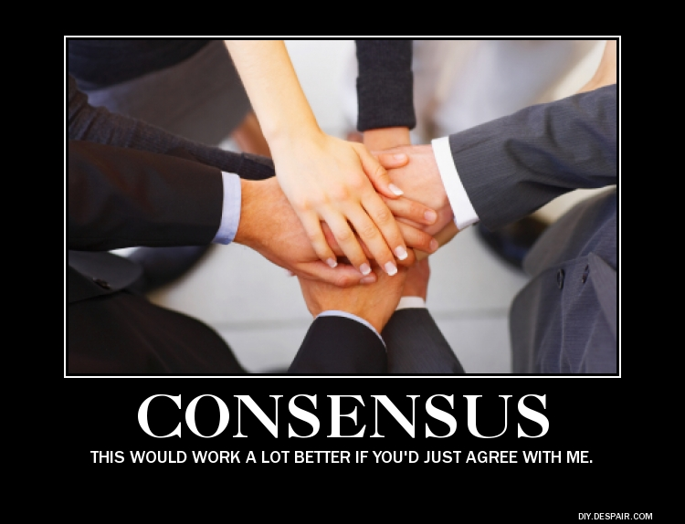
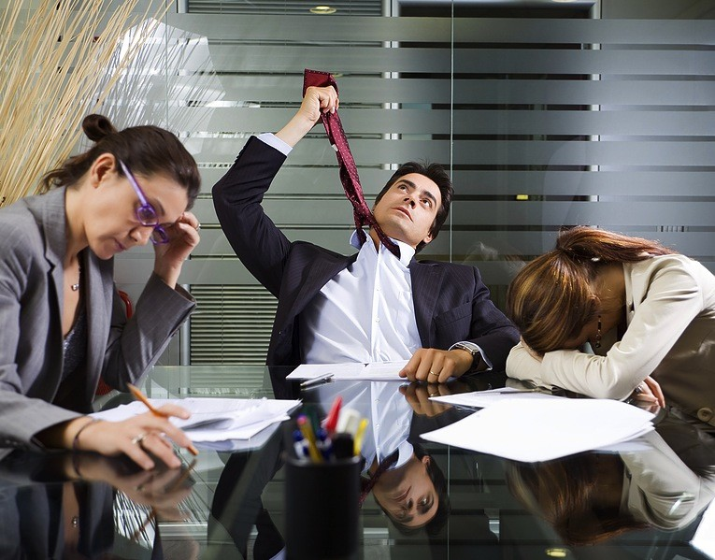
Building consensus isn’t always easy
What we wish it looked like
What it really looks like
https://joshyuter.com/2014/04/06/special-features/yutopias-10th-year-anniversary/conceits-consensus-halakhic-rhetoric/
https://seapointcenter.com/the-art-of-hosting-meaningful-meetings/
Notes:
But building consensus isn’t always easy, right?
What we want is for everyone to just immediately buy in to our viewpoint and agenda. Rarely is it that easy though. There’s going to be some hard work, and some occasional – or maybe a lot – of frustration as we have to guide everyone into consensus. Sometimes before we can even get to consensus, we may have to work through shared terminology and definitions.
{{ TALK ABOUT STRUGGLE TO DEFINE “CONVERGENCE” WITH THE ALL THE INVOLVED PARTIES }}

Slide 12
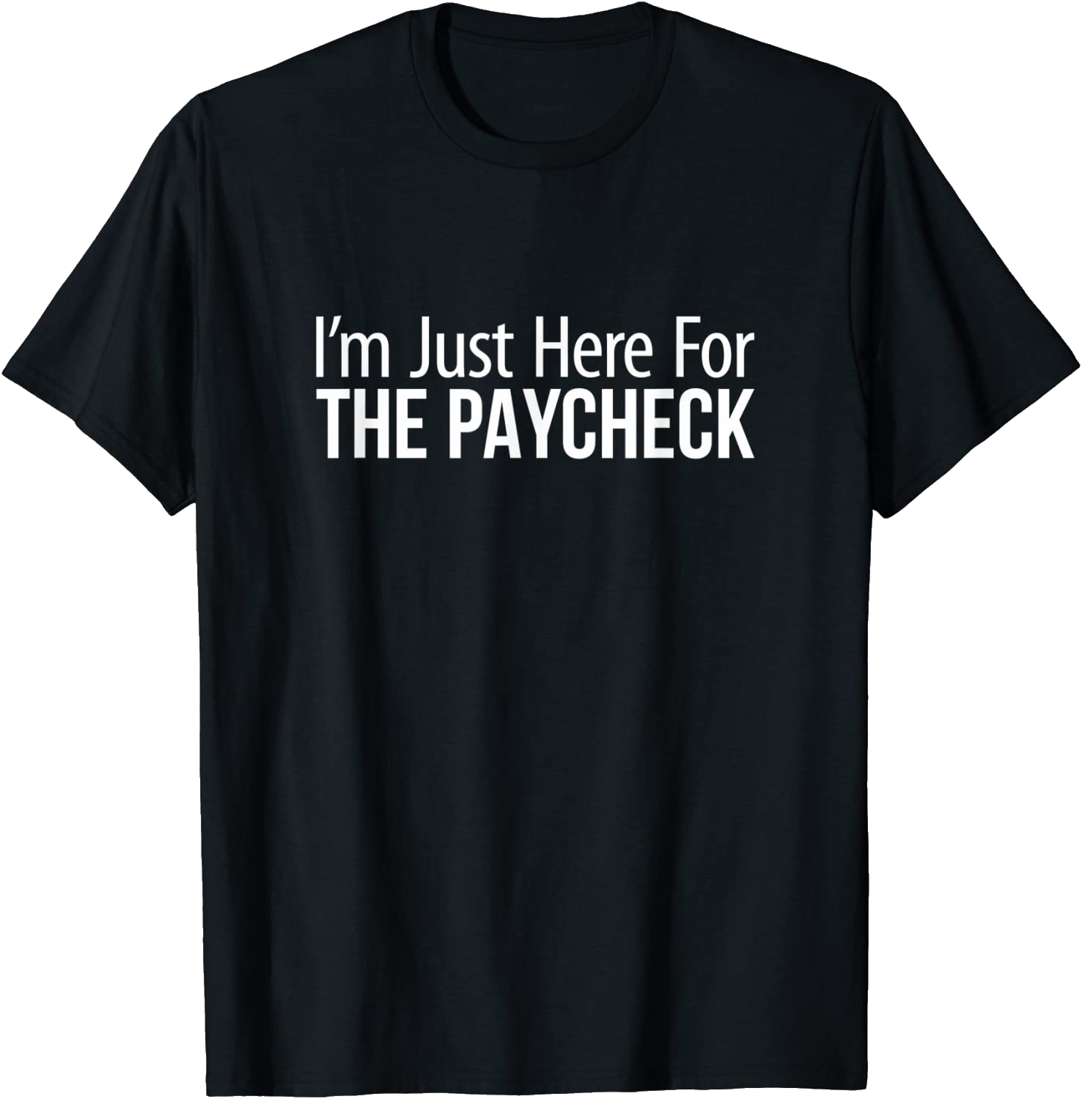

Can’t I Just Ignore All This?
Apathy
Aversion
https://www.amazon.com/Im-Just-Here-Paycheck-T-Shirt/dp/B0B4VLQ2W8
Notes:
There are two common reactions that folks can have in this situation, and neither lead to survival.
Apathy – waiting for exact instructions, not actively exploring how to clear roadblocks. Probably not in this audience
There is a subtle variation on this that can happen when progress doesn’t seem possible even after trying hard to resolve issues
Aversion – avoid the controversy, go heads down on what I’m good at, even if it doesn’t solve the customer’s problem
* This looks productive because activity is happening and artifacts are being created, but it isn’t a solution

Slide 13

You’re judged by the expectations you fulfilled, not the feats you accomplished.
https://www.istockphoto.com/photo/good-and-bad-news-gm187407339-28842888
Notes:
{{{ DO NOT SPEAK FOR 10 SECONDS }}}
Everyone who’s multitasking probably just swiveled back to check the connection. I paused there deliberately, because this is a key takeaway.
You’re judged by the expectations you fulfilled, not the feats you accomplished. That’s the bad news.

Slide 14

It’s our job to meet expectations…and we get to set the expectations.
https://www.istockphoto.com/photo/good-and-bad-news-gm187407339-28842888
Notes:
But there is good news.
While it is our job to meet expectations…we get to set the expectations. This is a nugget of wisdom shared with me years ago by an old coworker. Thanks Glenn Burnside, wherever you are! This aspect will be obvious to some, but for others like myself that doesn’t naturally like negotiating or “arguing”, this bite-sized phrasing has been perfect to push me to action and clarify when it’s needed.

Slide 15
Ask Everyone Lots Of Questions
1.
What can I help you do?
2.
What does “wild success” look like?
3.
Who do you see me working with to accomplish this?
4.
What happens if we don’t accomplish this?
5.
Why are we doing this?
What do you like to ask?
Notes:
Before we can set those expectations, we have to get on the same page as everyone else.
When you first join, you’re going to have to ask a lot of questions just to load the overall context into your head. These are some good starters.
I particularly like “what does ‘wild success’ look like” because it helps prompt people to articulate the capabilities and benefits, not just the desired end state.
I also like “why are we doing this?” to help level-set on the current pain points we’re trying to solve.
I’d like to open it up to audience – I’m curious what questions you find valuable and why?

Slide 16
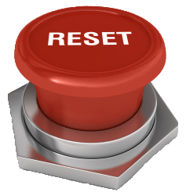
Set (Reset?) Expectations
We frequently join efforts mid-stream -
sometimes we have to have a candid discussion about what’s actually possible.
https://www.iconspng.com/image/139032/reset-button-on-metal-stand
Notes:
For this recent assessment, the assumption of the executives, and conveyed to me by our primary stakeholder, was that moving all 6 products could be done in three months. I didn’t push back immediately – maybe these were all cookie cutter, super simple apps and environments – but when it became apparent that wasn’t the case, I had to reset the framing.
Another project I was involved in a few years ago was a green field rewrite over an existing database. The CTO wanted us to do an offline web app for field technicians servicing industrial equipment. Tooling and techniques for offline web apps was very nascent at the time, and there were concerns about securing the data both in transit and at rest. We spent some time trying to design something we could actually deliver, when user interviews uncovered that there was a strict “no electronics allowed” near the equipment. That settled the question very quickly, since paper was going to be involved no matter what. We provided this context and set the expectations about what design made sense with the CTO, and moved forward with a more traditional “always online” web app.

Slide 17
You’re Still Going To Get Surprised
Notes:
Even with all the questioning, you’re still probably going to have some surprises.
I was on an architectural assessment for a mainframe modernization project with a large life insurance company. It turned into an implementation follow up, and one of the improvement opportunities was to reduce the number of form templates the beneficiary department had to maintain to acknowledge changes and life events. They had over 100, and we worked with them to streamline it down to about 20. We talked to everyone – the beneficiary department supervisor thought it was a good idea, the client’s technical team and printing team approved, the executive stakeholders thought it made sense……. {{{ PAUSE, THEN NEXT SLIDE }}}

Slide 18
You’re Still Going To Get Surprised
Notes:
…and then the Legal Department suddenly chimed in with concerns, and we spent four months going back and forth about whether and what documents we could streamline. So, plan on the unplanned as best you can.

Slide 19
Survive!
Organize!
Thrive!
Define
Organize
Execute

Slide 20
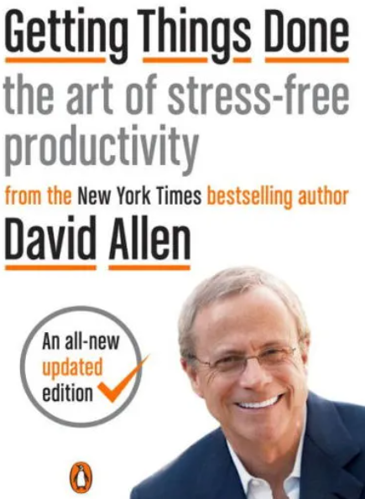
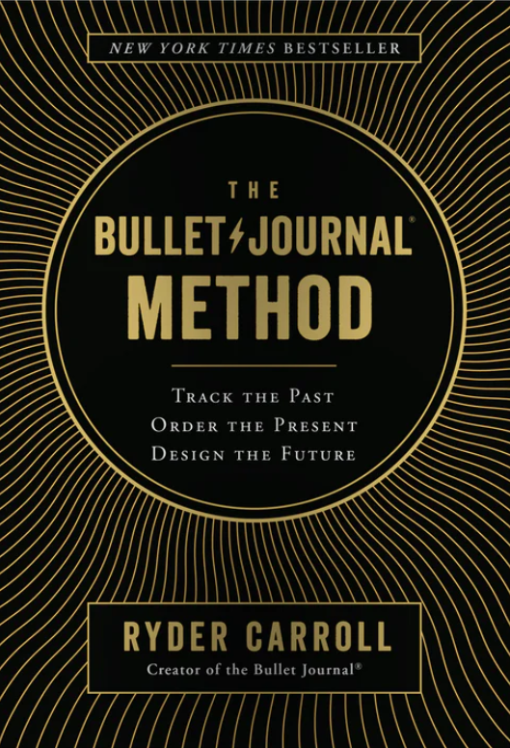
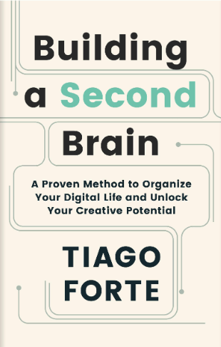
Major Sources Of Influence
Notes:
I use of mashup of several methodologies. Specifics are always evolving, so what I show today isn’t what I was doing a year ago, and may not be exactly how I operate next year.
One thing I have learned over time is what’s important, to large extent, is the underlying technique and not the tools themselves.

Slide 21
My Tool Biases
I avoid online only tools for real-time information capture
I’m looking at you, Microsoft OneNote
Notes:
I’m not completely adverse to online-only note taking apps – I use Apple Notes on my phone for personal use – but after typing a nontrivial amount of information from a user interview into an online input that had a bad synch and was completely lost – any real-time capture, which is primarily conversations, goes into an offline tool.

Slide 22

My Current Go-To For Notes
Notes:
Reminder, it’s about the techniques and capabilities, not the tools. If you’re doing great with whatever you use, I’m not going to tell you to switch.
Can open a folder and have a built in file explorer to see and search across all related docs within a project folder
Supports MarkDown, a very popular lightweight text formatting system
Auto-saves any new file, even across system reboots
Many other features aimed at technical folks that I won’t go into, but that make it appealing to me personally

Slide 23
The Daily Log
Notes:
Let’s talk about one of the most flexible tools that is often the primary point of capture throughout the day for activities, thoughts, recommendations, links to read, and so forth.

Slide 24
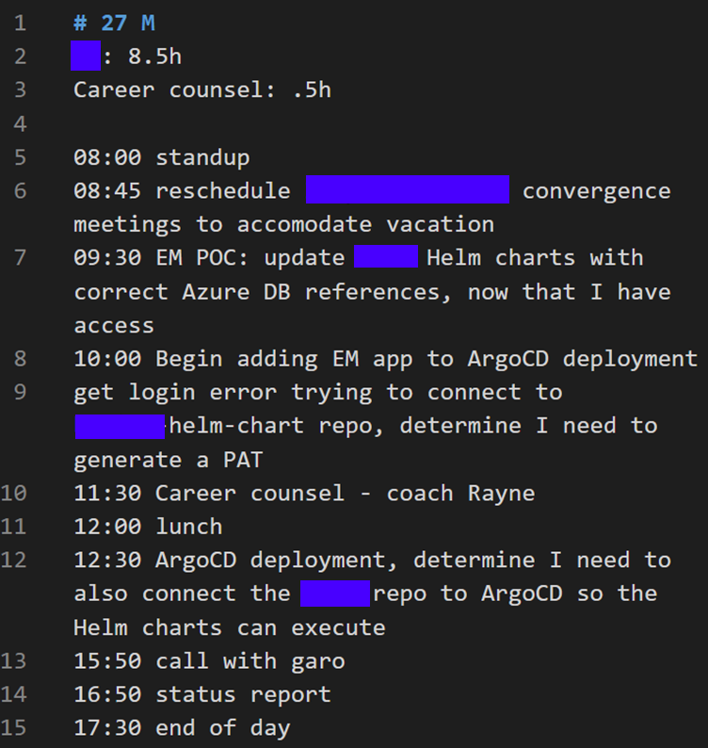
Record of what I was doing throughout the day
Inspired by Bullet Journaling
And 7 Habits of Highly Effective People as the Daily Record of Events
Logging time accurately is easy
Enables ability to compile effort metrics, even if client doesn’t require it (yet)
Notes:
This involves making an entry every time you shift tasks. That sounds awful, and it does take a week or two to get in the habit, but once it’s second nature it doesn’t take very long at all. At the end of the day I will sometimes (but not always) add up the totals by bill code for entry.
I’ve tried using software with timers in it, but inevitably would fail to stop a timer at some point and be frustrated by the lost value. I’m not perfect about this either, but because I’m so in the habit of referencing the clock when I change tasks, I can pretty easily catch up towards lunch or end of day if I’ve missed something.
{{ RECOUNT BEING AT CUSTOM MANUFACTURING CLIENT AND TABULATING MY INTERRUPTIONS FOR FLOOR SUPPORT TO JUSTIFY MY LACK OF FEATURE COMPLETION AFTER CLIENT ASKED FOR ANOTHER TEAM MEMBER TO BE REMOVED FOR LACK OF PERFORMANCE }}

Slide 25
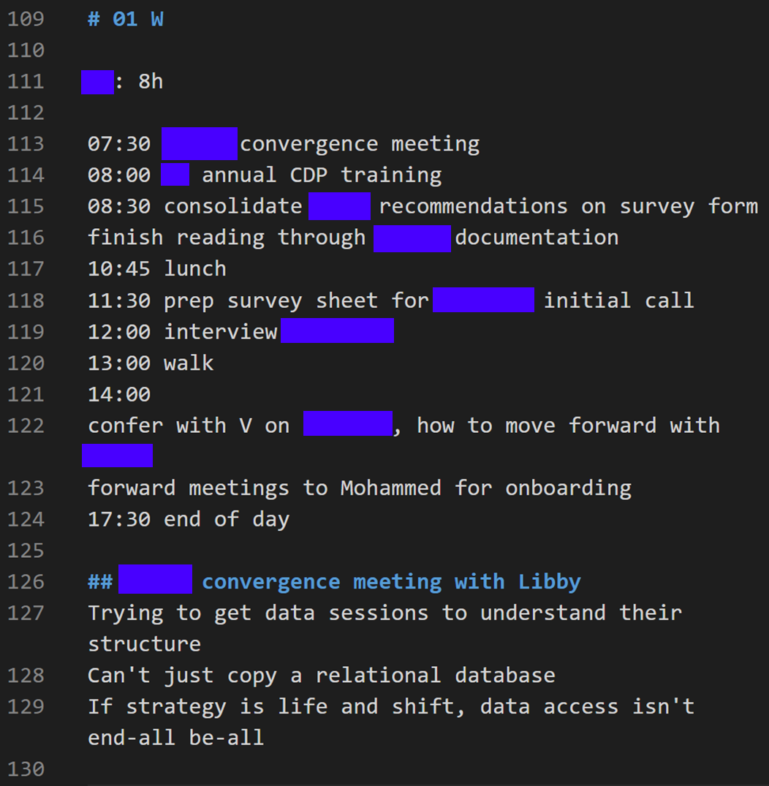
Ad-hoc Information Capture
Perfect for journaling unexpected conversations and events
These can be extracted into a better location later
Notes:
Note how the convergence meeting notes are a subsections, and collapsible within VS Code

Slide 26
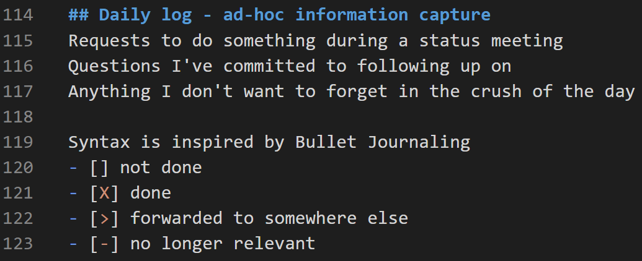
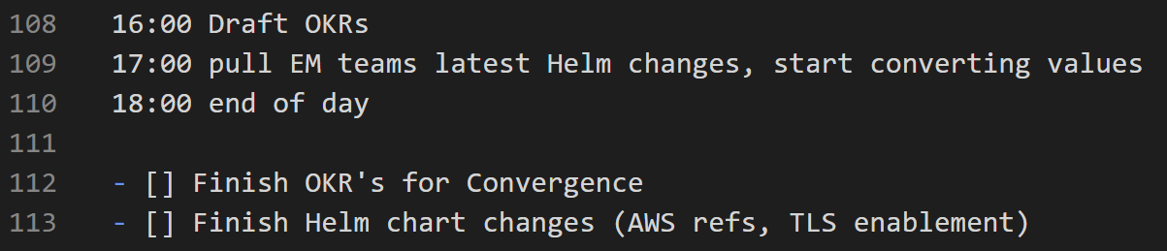
Small “one off” To-dos
Perfect for single actions where defining a parent project is overkill
Notes:
{{ TALK THROUGH THE STATES OF TODO, HOW THEY GET FORWARDED }}

Slide 27
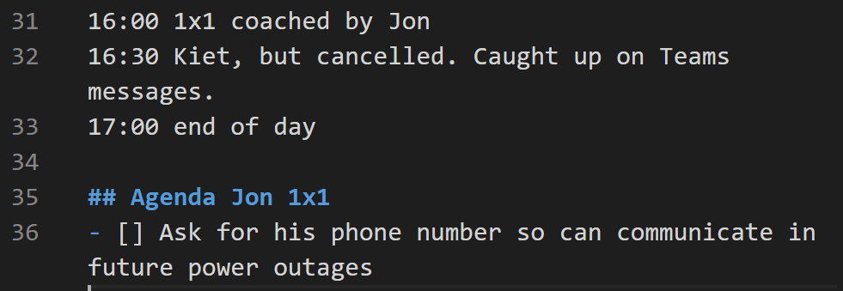
Event specific agendas
Usually these are for my repeating events - singular meetings should have a well defined agenda on the meeting invite

Slide 28
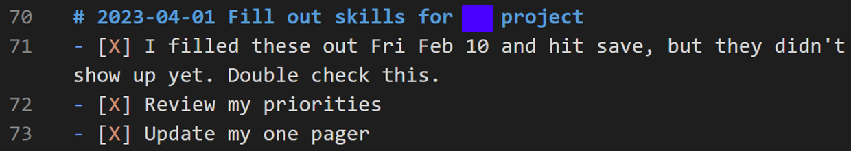
Small project tracking
Larger projects will either be in data store used by the entire team (Teams, JIRA, etc.) or in a dedicated file folder
Notes:
Notice the “due date” on this node. When I close out a week on Friday and migrate to a new weekly file, I’d see this was a small future scheduled project, and copy it into the next week.

Slide 29
The PARA Method
Notes:
Almost everything else - email, notes, bookmarks – I’ve started using the PARA method.
The PARA method is a concept I learned from the book “Building A Second Brain”. It’s been a complete game changer for me personally. I’m so sold on it, I put the premise behind it a quote slide. Ready?

Slide 30
“Organize information based on how actionable it is, not what kind of information it is.”
Notes:
{{ READ THE SLIDE }}

Slide 31
The PARA Method
P
A
R
A
Projects
Areas
Resources
Archives
Short term effort in your work or life that you’re working on right now
Long-term responsibilities you want to manage over time
Topics or interests that may be useful in the future
Inactive items from the other three categories
Notes:
Here’s a breakdown of the four categories in PARA.
{{ Briefly discuss }}

Slide 32
“Instead of requiring tons of time meticulously organizing your digital world, PARA guides you in quickly sorting your ideas according to what really matters: your goals”
Notes:
OK, wall of text, sorry. But it’s a great summary of the value proposition. {{ READ THE SLIDE }}

Slide 33
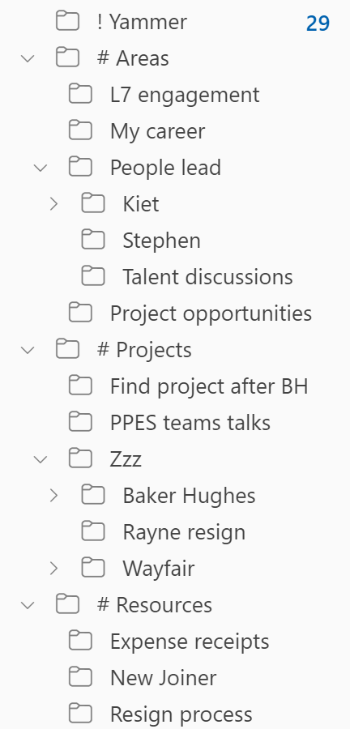
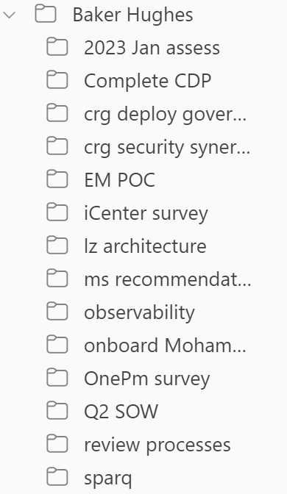
PARA - email
A complex project, expanded
Notes:
{{ REVIEW THE FOLDER STRUCTURES }}
While we’re on this slide, I’ll point out two fairly obvious email survival tips. Most of us already know them, but it’s worth taking 30 seconds for that one person who hadn’t thought about it, or maybe just needs a gentle reminder to get back on the band wagon.
Use filters for repetitive email. In this screenshot, I’m filtering all my Yammer emails into a single folder, and bypassing my inbox. This keeps me from being distracted by what is often “low signal, high noise” emails until I’m ready to go through them in bulk
Be relentless in striving towards “inbox zero”. File it, and categorize it for follow up if needed, as soon as possible so you can keep your inbox count low. When it stacks up the odds of losing track of something important start to quickly go up.

Slide 34
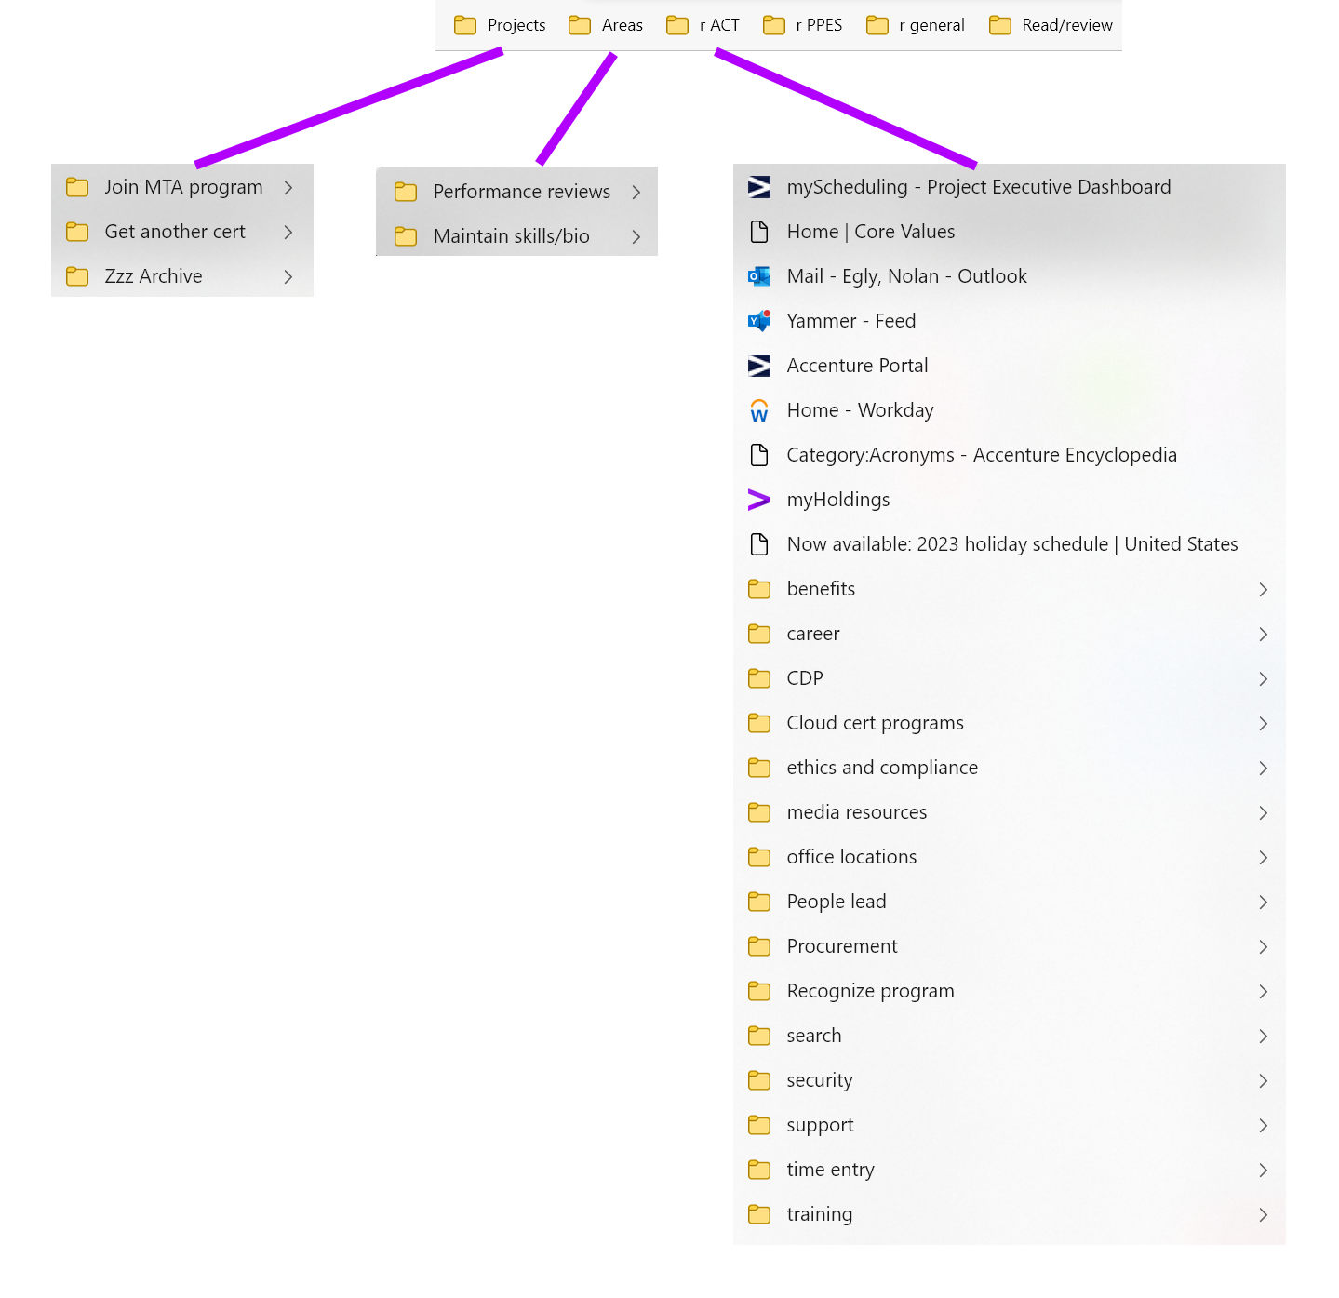
PARA - bookmarks
Notes:
{{ POINT OUT READ/REVIEW FROM GETTING THINGS DONE METHODOLOGY }}

Slide 35
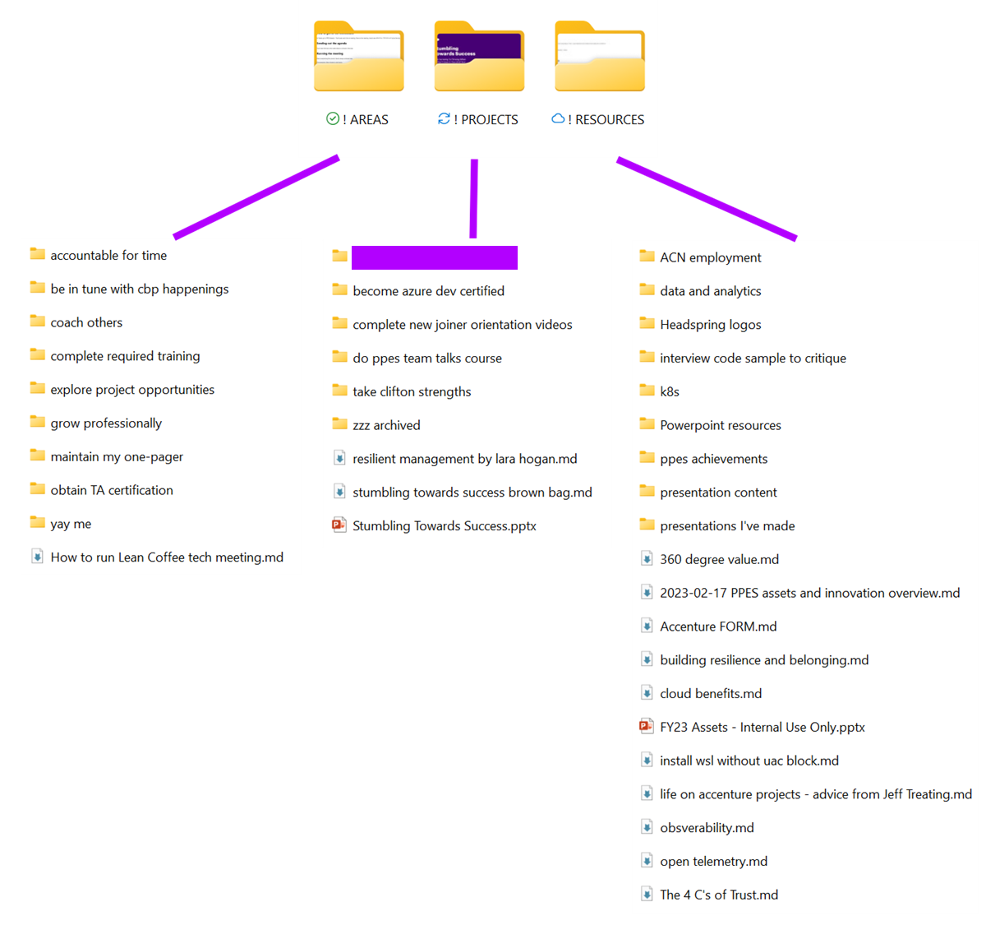
PARA – file system

Slide 36
Keeping Notes Within A Project
Notes:
For the last section in “Organize!”, lets talk about keeping notes within a large project

Slide 37
Project Notes Are Messy
The structure is always evolving
The temptation to overly organize
As your understanding grows, you’ll have “eureka” moments about concepts and people relationships that trigger rearrangement
Vagueness about responsibilities or goals will be reflected in the organization of your notes
Try to group by an area of focus, and not pure chronology. It’s easier to see a “running log” of conversations that way
Resist the temptation to apply a large organizational effort for a minimal effectiveness gain
Tagging
Fine-tuning folder hierarchies (which is a single value tagging system)
Lean on raw text search, it covers 99.9% of lookup needs

Slide 38
Be Considerate Of Your Successor
Always be asking “should this be a shared resource”? Some notes have to stay private (e.g. personal observations), but much should be organized for the project team
When you have to learn new information and there’s no reference material, create it for the next new person based on the conversations you have with the people who already know

Slide 39
Survive!
Organize!
Thrive!
Define
Organize
Execute
Notes:
Now that we’re surviving with a common definition on what we’re doing, and we’ve organized the firehose of information we’re drinking from and tasks we’re managing, we can start thriving by executing the project. This last section doesn’t have a definitive arc, it’s more of a potpourri of mindsets and tips that I feel are useful.

Slide 40
Core Character Traits Needed
Notes:
One viewpoint about human capability is that we’re born with certain innate traits, like being an outgoing sociable extrovert or an inward reflecting quiet introvert, and that these character traits are fixed and completely define what we can do.
I agree it’s true we all have innate character traits, but I don’t believe that’s the whole story. So let’s fix this slide…give me a second…{{{ TRAIL OFF, WAIT A SECOND, THEN ADVANCE TO NEXT SLIDE }}}

Slide 41
Core Character Traits Needed
Behaviors
Notes:
There we go, that’s better. People can step up and act in different ways when they have to, it just takes more effort and energy. As we talk about “what people have to do”, keep in mind it isn’t about personal character or personality, it’s about being able to act in a way that’s needed. Just because someone is shy doesn’t mean they’re completely unable to present or address or group, and just because someone is outgoing and gregarious doesn’t mean they can’t go heads down and focus intensely for several hours by themselves. Keeping that in mind… {{{ NEXT SLIDE }}}

Slide 42
Behaviors Needed
1.
Self-starter
Discipline, driven to deliver value, does actions under their own initiative, persistence
2.
Egoless
Not afraid to be wrong or appear clueless while learning
3.
Communicate
Candid, clear, timely (doesn’t sit on bad news)
4.
Collaborate
Seek the expertise and opinion of others, works with team members
What behaviors do you think are important?
Notes:
Here are some of the core behaviors that I feel are needed for people, working alone or on a team, as an individual contributor or as a decision maker, need to possess.
{{ GO THROUGH THE BEHAVIORS }}
{{ ASK AUDIENCE: WHAT DO YOU THINK IS IMPORTANT? }}

Slide 43

Leave A Digital Footprint
https://www.datavisor.com/wp-content/uploads/2019/07/Exposing-the-Digital-Footprints-of-Fraud-back.jpg
Notes:
Leave a trail. The scope and shape of a project will change in many ways as it progresses, and this is totally natural because the only way to completely know how to accomplish a unique complex task is to…do the unique complex task. Evolution is inevitable, but you want to have concrete proof for agreement of all the dynamic adjustments that happen along the way
If you have verbal conversations where decisions are made/approved, send a follow up email with the agreement details.
cc yourself outside the client email, in case you lose access
If you have a formal change control process, you’re probably looking at having to do document signatures.

Slide 44

Corral Your Calendar
You’re going to have two at times
It sucks, deal with it
Keep them in synch, so people at both places know your availability
Any meeting you create, pre-emptively add your other to reduce synch effort
Block off when you’re asleep or other hard “not available” boundaries
https://www.wrike.com/blog/time-management-calendar/

Slide 45
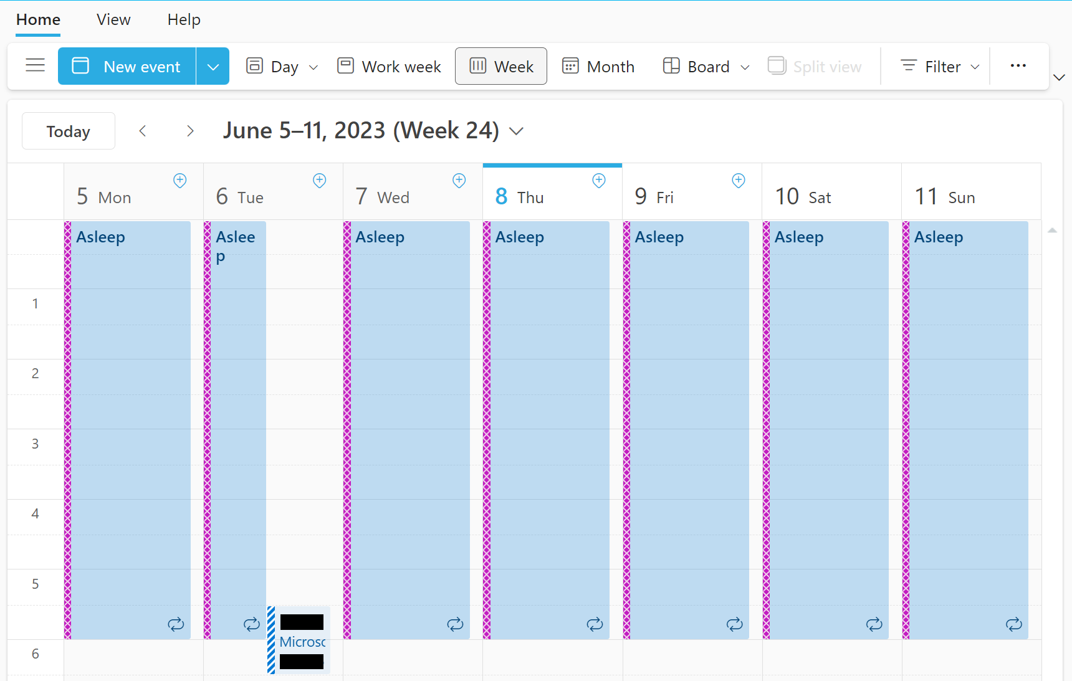
Corral Your Calendar
Block off when you’re asleep or other hard “not available” boundaries
Notes:
Notice that 05:30 in the morning meeting? Whoever sent that to me would have immediately known I wasn’t available, because I blocked off my local sleeping time as unavailable.

Slide 46
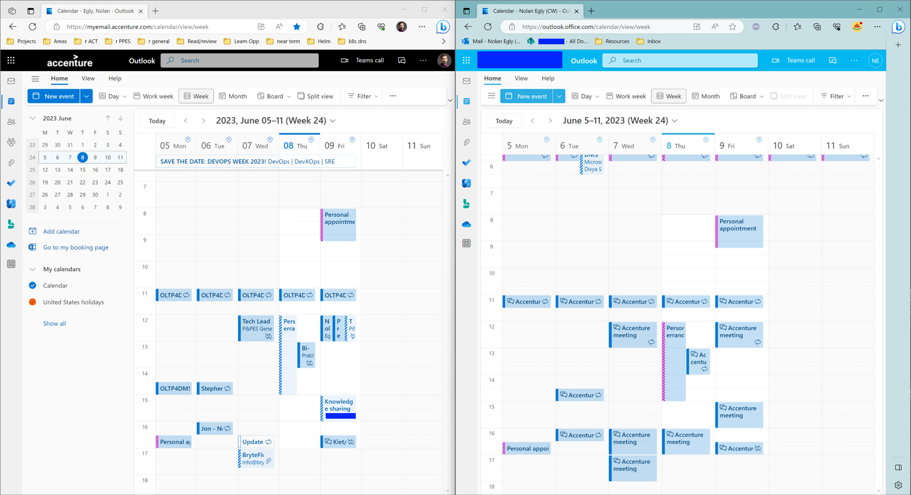
Corral Your Calendar – Keep multiples in synch
Notes:
Here’s an example of keeping my company calendar and my client account calendar in synch. First thing every Monday I reconcile the week ahead, and then as meetings get added, canceled, or moved I update both at the same time.
Another strategy that’s helped me is having a separate browser profile for the client and giving it a different window color. Here on the left, in standard Windows color, is my company browsing. On the right, in blue, my client. This lets me keep client-specific bookmarks in a separate profile, and makes it easy to visually see what type of tabs I’m working with – company or client.

Slide 47


Manage your time well
Figure out your daily/weekly rhythms with the team
Block off focus time to get things done outside meetings

Slide 48
Distilling notes from a meeting
Notes:
On my previous project I was doing many tasks by myself. Now I’m working with a team, and as our group has been interviewing client folks, I’ve been scribing the meetings for future reference by everyone.
I’ve had several team members tell me this has been very useful to reference later, so I thought I would share what that final output looks like, and then talk about the process to get there.

Slide 49
Demo – polished meeting notes
Notes:
Show a final transcript in OneNote

Slide 50
Nolan’s Note Taking MasterClassTM
During the Call
Go for quantity over quality
Type what you hear verbatim. Drop noncritical words when you can (articles, prepositional phrases, when speaker repeats themself in a slightly different way)
Prioritize typing speed over accuracy
Don't stop to fix typos, you can do that later
Don't stop to think or replay the sentence in your head
If you didn't get part of it, type ???? and keep going. If you stop to think, you're going to miss even more. Often you can backfill what you missed in the conversation that follows.
Abbreviate when you can.
Speaker names are an obvious choice. Concepts that were spelled out in full earlier can be truncated.
5. Prefer an off-line text capture tool
Notes:
{{ READ THROUGH THIS, BUT DON’T BE SLOW }}

Slide 51
Demo – raw meeting notes
Notes:
Show a raw note in VS Code

Slide 52
Nolan’s Note Taking MasterClassTM
After the call: clean up and fill out for long term preservation
Ideally do this the same day
before you sleep and lose your short-term memory around the conversation
Read through top to bottom, slowly, from the perspective of someone who wasn't there or doesn't remember much (which will effectively include you in a few weeks!)
Expand and reword so it can be read without filling in gaps based on memories of being there
Optionally, scan through and add summary headers at major conversation junctions
Optionally, add reflections on your impressions outside the content
speaker tones, non-verbal cues, etc.
Verbatim notes won't convey that, and sometimes it matters (speaker was tentative on committing to something, seemed agitated about certain points, etc.)

Slide 53
Nolan’s Note Taking MasterClassTM
Trade offs
Realtime capture is harder when you have to be involved in the conversation
Based on the stakes/risks around the meeting:
Appoint a scribe, if possible
Record the meeting and transcribe it later, if possible
Deliberately slow the pace of the conversation (hard when more than a few present)
Accept a loss of quality in your notes

Slide 54
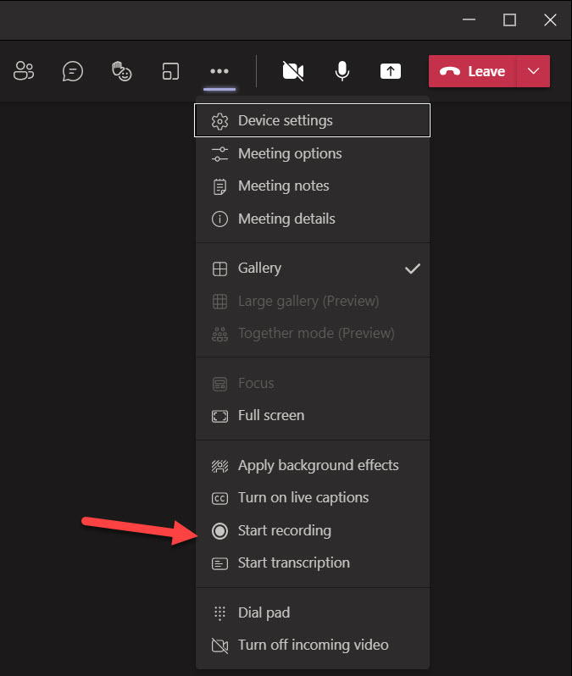
What about Record and Transcribe?
Notes:
Earlier this year Microsoft introduced transcriptions for meetings. You have to request the transcription at the same time you start a recording, you can’t ask for a transcription after the meeting and recording are done.
I’ve tried it a few times. So, what do I think? …. {{ NEXT SLIDE }}

Slide 55
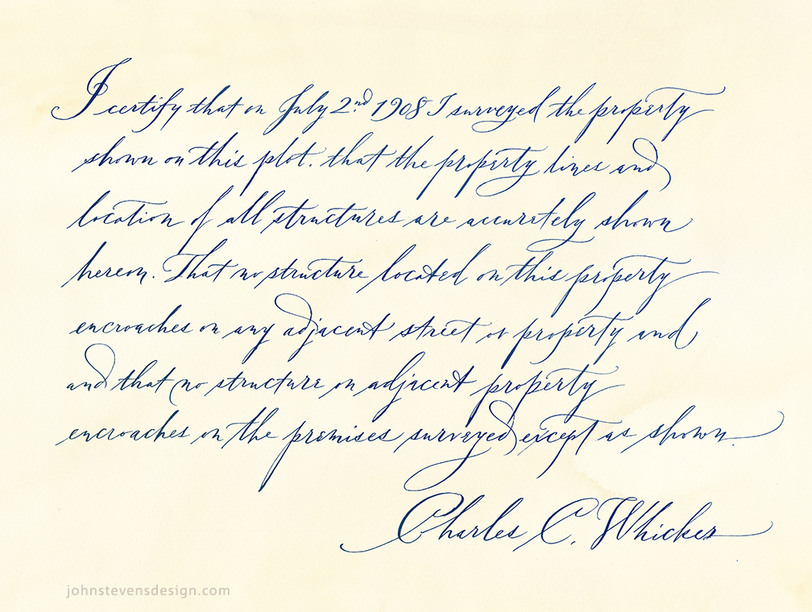
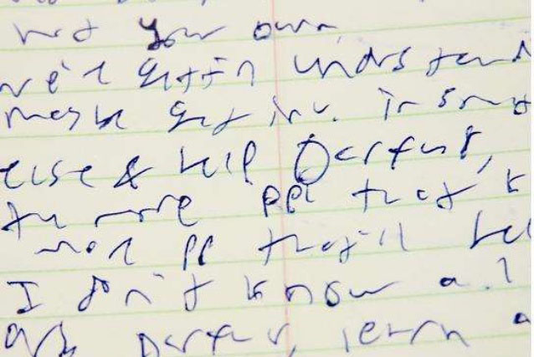
What about Record and Transcribe?
Expectations
Reality
https://www.johnstevensdesign.com/handwriting-styles/
https://www.shippingschool.com/five-fun-facts-about-the-us-postal-service/bad-handwriting/
Notes:
I’m actually not too enthralled with it. It seems like it would be a life saver, and it IS better than nothing, maybe? I feel it has several big issues that limit the usefulness.

Slide 56
Problems with Record And Transcribe
Quality of the transcription varies based on speaker’s articulation, microphone, and environment
Simultaneous talking comes out disjointed
“Umm”, “uh-huh”, “right” from listeners
Two people finishing each others sentences
Reading a literal transcription is harder than a distilled one
Many people form their thought verbally in a round-about way that a human can distill down to a more compact readable expression
Notes:
The first issue is obvious and is something that all of us would probably think about, but there’s also several non-intuitive issues I’ve noticed since trying the feature.
Obvious transcription errors
“million things open” => “Brazilian things open”
“Umm…” => “Dumb”
Client specific acronyms get mangled. “OMS, TMS, WMS” => “Ms., Ms., DOS”

Slide 57
Thank you!
Notes:
Questions? Comments? Queries? Concerns? Compliments? Hot stock tips? The floor is open for discussion!

